Slide 1
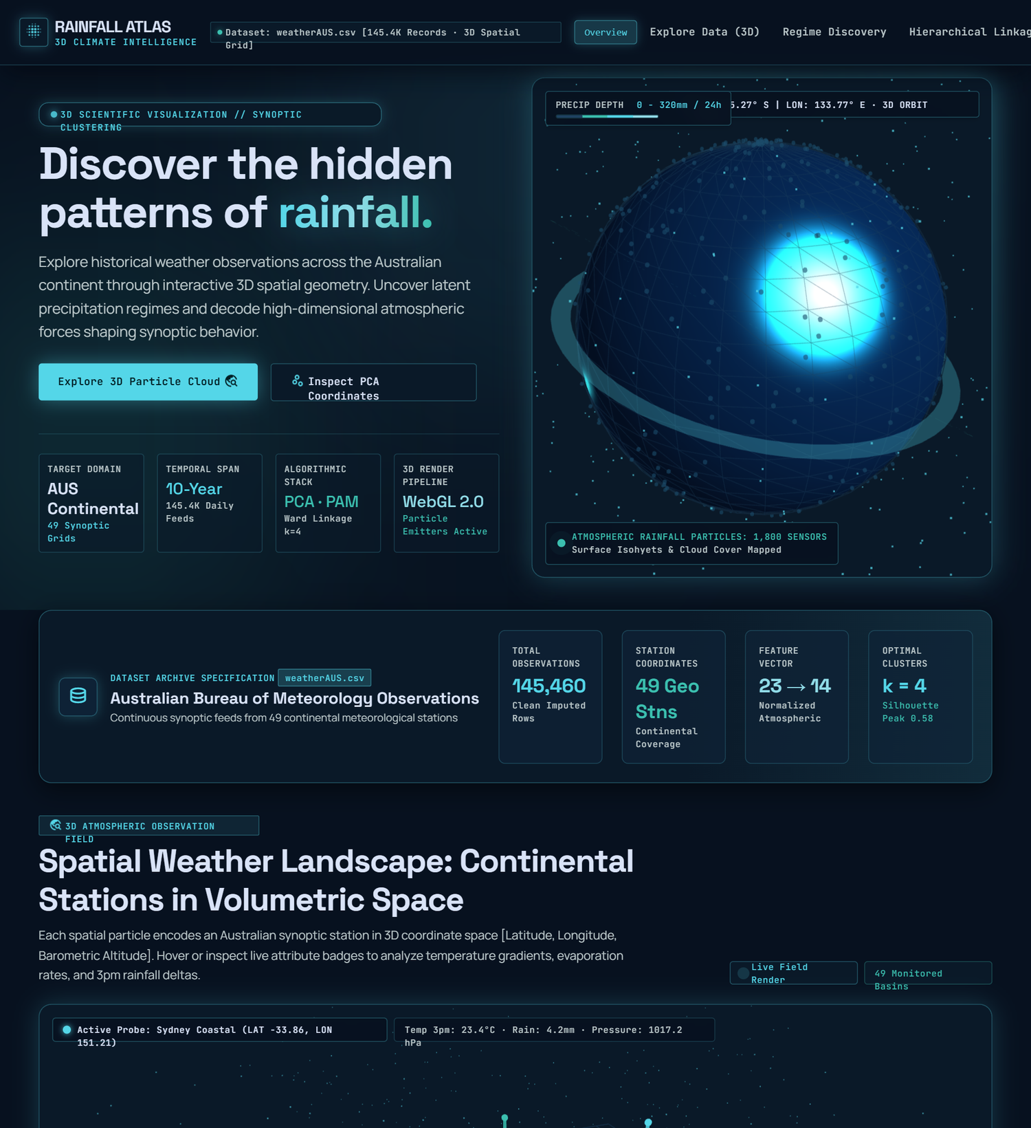
RAINFALL ATLAS
NATURAL RAINFALL REGIME
DISCOVERY FROM HISTORICAL PATTERNS
3D Climate Intelligence Platform
SUBMISSION DETAILS
Name : Sagar Khandai
Registration Number : 12508282
Branch – Computer Science And Engineering(AI & ML)
Guided By : Hitesh Jangid
Complete all bracketed fields before final upload.
RAINFALL ATLAS • NATURAL RAINFALL REGIME DISCOVERY
01

Slide 2
01 · INTRODUCTION
Why discover rainfall regimes?
Historical weather observations are multidimensional and do not arrive with predefined regime labels.
THE CHALLENGE
THE APPROACH
THE OUTPUT
Daily measurements combine rainfall, temperature, humidity, pressure and wind. Manual inspection across many locations and years is difficult.
Use unsupervised clustering to group observations with similar feature patterns, then inspect whether the group profiles are interpretable.
A reproducible analysis pipeline, model comparisons, PCA views, empirical profiles and a 3D web interface for exploration.
Scope: exploratory historical pattern discovery — not rainfall forecasting or official climate classification.
RAINFALL ATLAS • NATURAL RAINFALL REGIME DISCOVERY
02

Slide 3
02 · OBJECTIVES
Project objectives and need
The project follows a traceable chain from data preparation to interpretation.
• Inspect and validate the historical weather dataset; quantify missingness, coverage and data quality.
• Prepare a justified numerical feature space, prevent future-target leakage, impute missing values and scale features.
• Evaluate K-Means across multiple K values using WCSS, Silhouette and Davies–Bouldin metrics.
• Compare Euclidean partitioning with Manhattan medoid-based clustering and agglomerative hierarchical methods.
• Use PCA, cluster profiles, geographical summaries and seasonal distributions to communicate patterns.
RAINFALL ATLAS • NATURAL RAINFALL REGIME DISCOVERY
03

Slide 4
03 · DATA
Dataset: Rain in Australia
Kaggle weatherAUS.csv · Historical Australian daily weather observations
145,460
23
49
2007–2017
daily rows
source columns
locations
date coverage
Coverage: 01 Nov 2007 – 25 Jun 2017 | Duplicate Date–Location pairs: 0
DATA QUALITY SIGNALS
PRIMARY 11 FEATURES
Rainfall missing: 3,261 values (2.24%)
Rainfall zero share: 64.05%
Rainfall skewness: 9.8362
Temperature (4), rainfall (1), humidity (2), pressure (2), wind speed (2). Location is metadata for grouping and spatial summaries.
RAINFALL ATLAS • NATURAL RAINFALL REGIME DISCOVERY
04

Slide 5
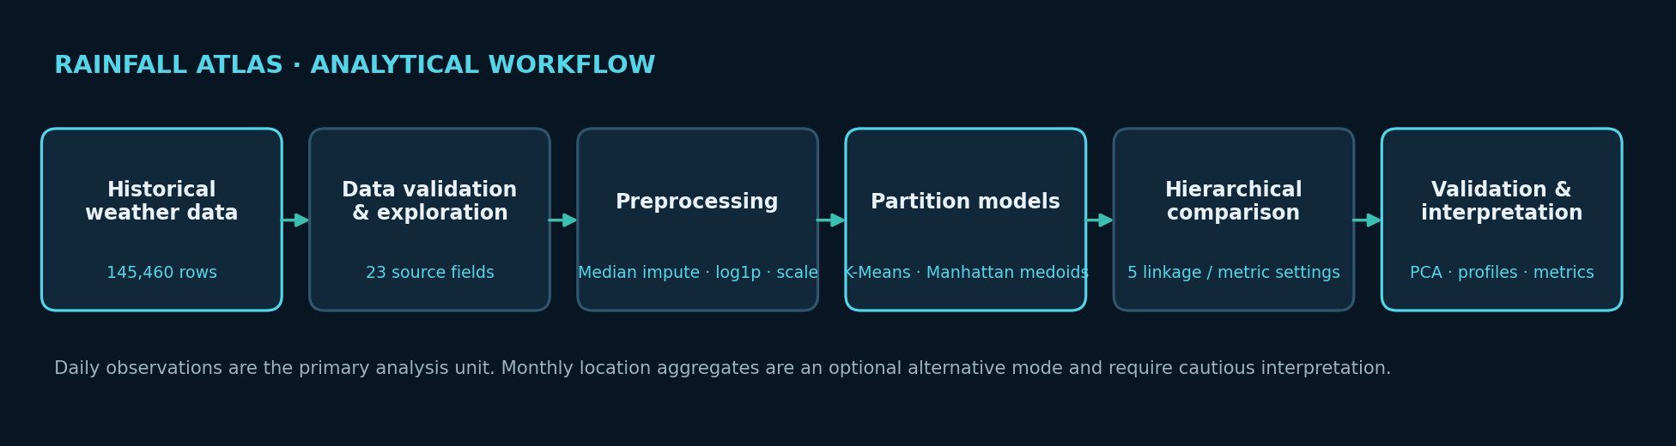
04 · PREPROCESSING
From raw observations to model features
Primary observation unit: daily weather observation.
• RainTomorrow and RainToday are excluded from the primary feature matrix.
• Numerical missing values are handled with median imputation.
• Rainfall is transformed using log1p to reduce extreme right-skew.
• StandardScaler transforms the selected features before distance-based clustering.
• Correlation statistics are computed; automatic correlated-feature removal is not implemented.
RAINFALL ATLAS • NATURAL RAINFALL REGIME DISCOVERY
05

Slide 6
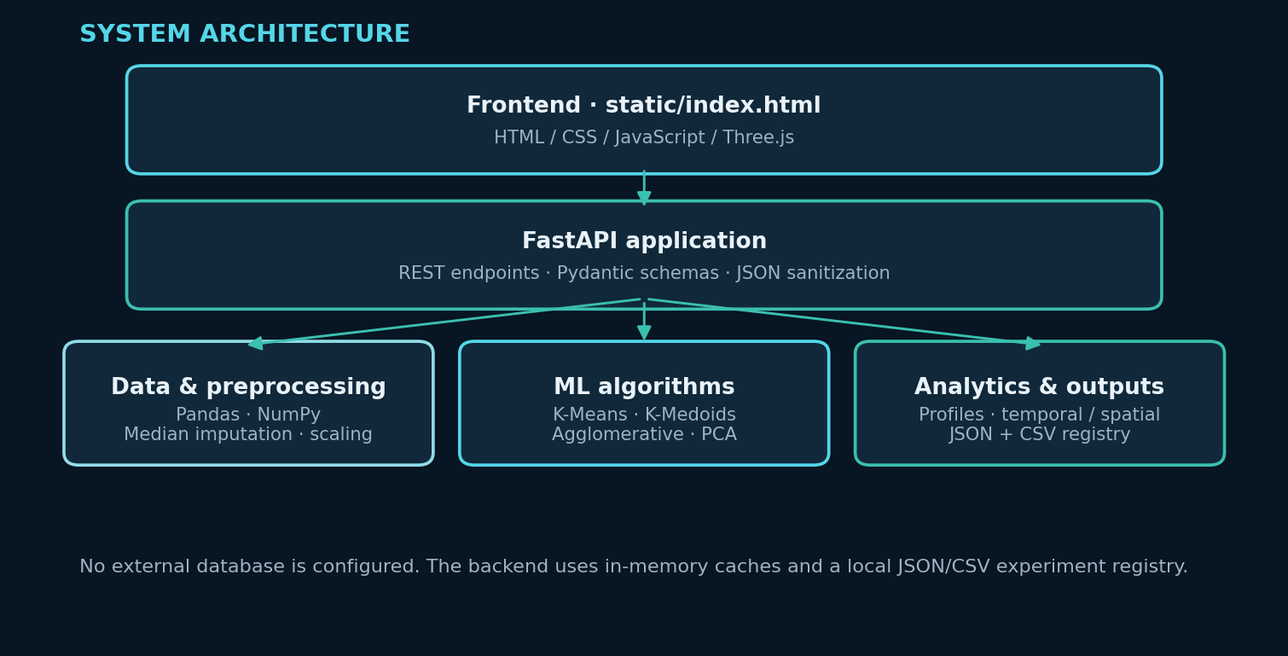
05 · SYSTEM
Application architecture
FastAPI serves the static web interface and exposes analytical results through REST endpoints.
RAINFALL ATLAS • NATURAL RAINFALL REGIME DISCOVERY
06

Slide 7
06 · PARTITION CLUSTERING
K-Means: Euclidean baseline
K-Means minimizes within-cluster squared Euclidean distance (WCSS / inertia).
ALGORITHM
EXPERIMENTS
INTERPRETATION
k-means++ initialization
n_init = 3
max_iter = 100
random_state = 42
K = 2, 3, 4, 5, 6, 7, 8
WCSS computed on full dataset
Silhouette and DBI on a shared n=2,000 validation sample
Higher Silhouette is better. Lower Davies–Bouldin is generally better. WCSS decreases as K grows and cannot select K alone.
RAINFALL ATLAS • NATURAL RAINFALL REGIME DISCOVERY
07

Slide 8
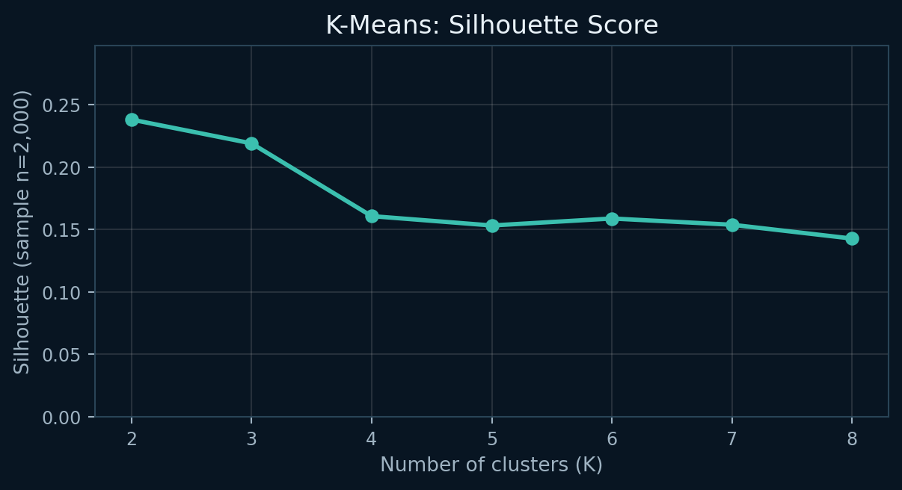
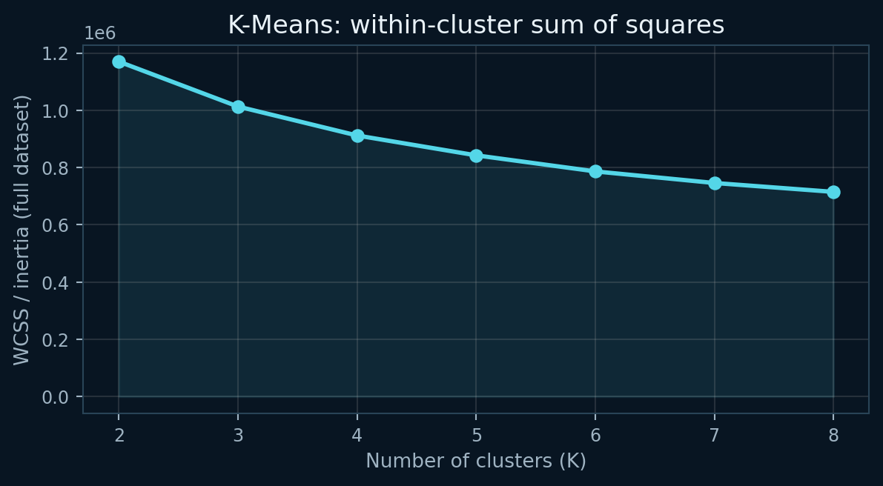
07 · MODEL SELECTION
K-Means model-selection evidence
The executed reference run uses seed 42 and a common 2,000-observation validation sample.
K | Silhouette | DBI
2 | 0.2382 | 1.5388
3 | 0.2191 | 1.6617
4 | 0.1608 | 1.6767
5 | 0.1533 | 1.6167
6 | 0.1589 | 1.6090
7 | 0.1539 | 1.5856
8 | 0.1428 | 1.6194
READ THE RESULT
K=2 has the strongest internal scores in this run. K=4 is retained as a more granular exploratory baseline, not a proven mathematical optimum.
RAINFALL ATLAS • NATURAL RAINFALL REGIME DISCOVERY
08

Slide 9
08 · STABILITY
Initialization stability at K=4
Five random seeds were evaluated: 42, 101, 7, 2024 and 99.
MEAN PAIRWISE ARI
WCSS MEAN ± SD
0.9824
911,971 ± 3.03
SILHOUETTE MEAN ± SD
DBI MEAN ± SD
0.1631 ± 0.0034
1.6739 ± 0.0101
High seed-to-seed ARI indicates similar assignments across these initializations; it does not prove strong cluster separation or climatological validity.
RAINFALL ATLAS • NATURAL RAINFALL REGIME DISCOVERY
09

Slide 10
09 · DISTANCE COMPARISON
Manhattan medoid-based comparison
The medoid method uses L1 / cityblock distances; its objective differs from K-Means WCSS.
Method (K=4) | Objective | Silhouette | DBI diagnostic
K-Means · Euclidean | WCSS 911,967.32 | 0.1587 | 1.6881
K-Medoids · Manhattan | SAD 943,105.69 | 0.1307 | 2.1062 (Euclidean DBI)
• The implementation selects medoids from repeated subsamples and refines medoids within assigned clusters.
• It is CLARA-style sampled medoid refinement; it is not a canonical PAM swap-search implementation.
• The Manhattan cost is estimated using a 5,000-row evaluation batch and scaled to the data size.
• The DBI shown is a supplementary Euclidean diagnostic; it is not a Manhattan-native DBI.
RAINFALL ATLAS • NATURAL RAINFALL REGIME DISCOVERY
10

Slide 11
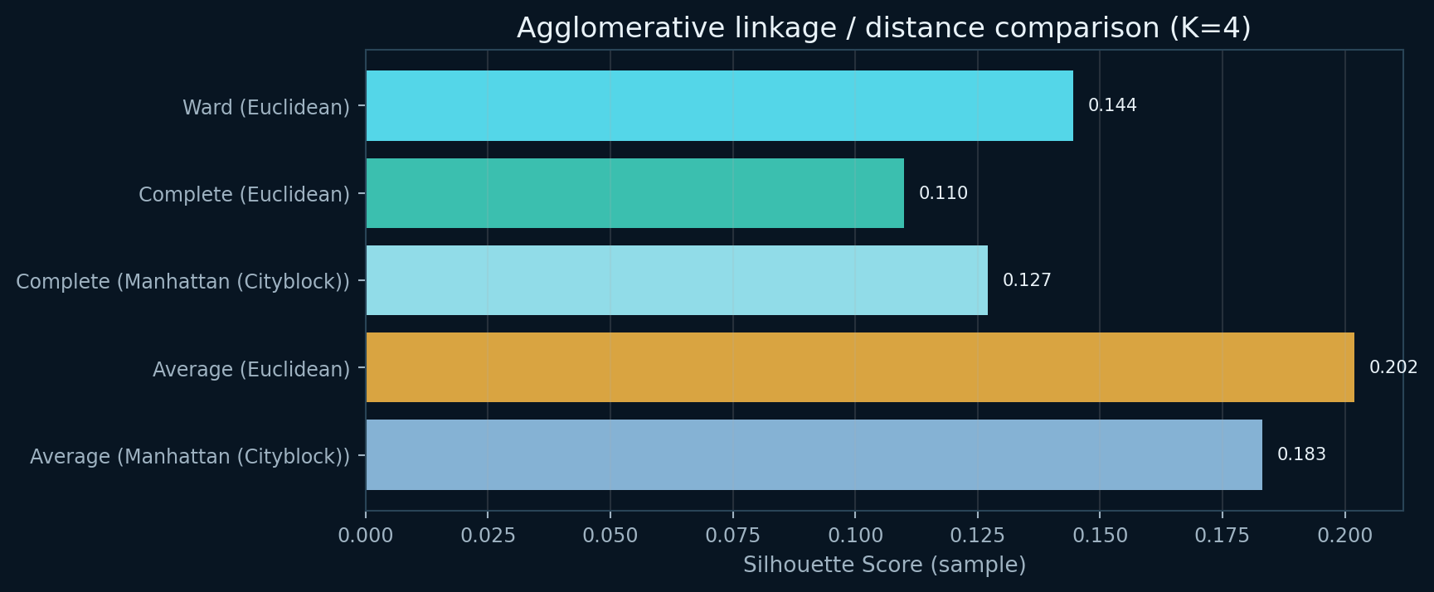
10 · HIERARCHICAL
Agglomerative linkage comparison
Five linkage / distance configurations were evaluated at K=4 on a station-stratified sample.
Linkage | Distance | Silhouette | Balance
Ward | Euclidean | 0.144 | 0.6652
Complete | Euclidean | 0.110 | 0.0565
Complete | Manhattan | 0.127 | 0.2075
Average | Euclidean | 0.202 | 0.0007
Average | Manhattan | 0.183 | 0.0027
Requested sample n=1,500; realized n=1,493 after per-location proportional rounding. Dendrogram is sample-based. Full-data extensions use nearest sample centroids and are approximate.
RAINFALL ATLAS • NATURAL RAINFALL REGIME DISCOVERY
11

Slide 12
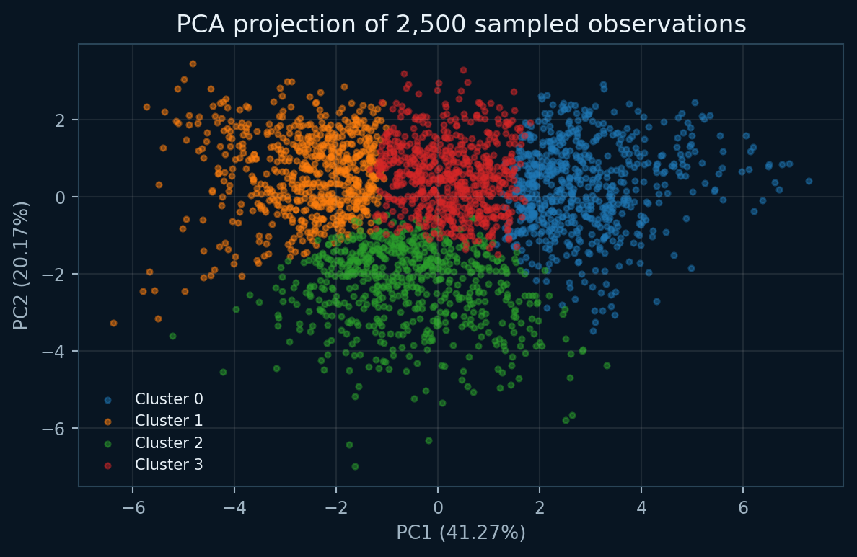
11 · DIMENSIONALITY REDUCTION
PCA latent space
PCA visualizes the standardized feature space; it is not the clustering algorithm.
PC1
41.27% variance
PC2
20.17% variance
PC3
13.53% variance
PC1 + PC2 + PC3 = 74.97% cumulative explained variance.
RAINFALL ATLAS • NATURAL RAINFALL REGIME DISCOVERY
12

Slide 13
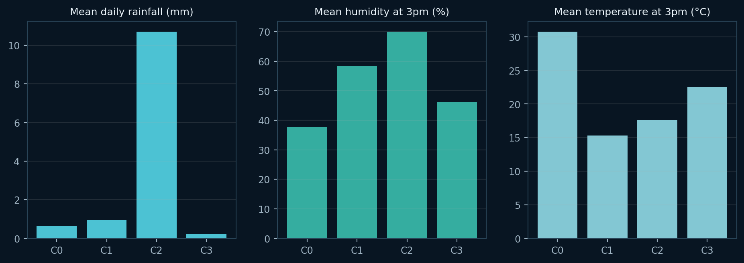
12 · INTERPRETATION
K=4 empirical cluster profiles
Use neutral cluster IDs and measured statistics; meteorological names are heuristic descriptors only.
Cluster | Share | Mean rain | Rain >1 mm
C0 | 22.4% | 0.66 | 9.3%
C1 | 25.0% | 0.95 | 18.9%
C2 | 17.5% | 10.71 | 76.6%
C3 | 35.1% | 0.23 | 5.9%
Cluster 2 has the highest mean rainfall (10.71 mm/day) and 76.6% of non-missing daily rainfall observations >1 mm within that cluster.
RAINFALL ATLAS • NATURAL RAINFALL REGIME DISCOVERY
13

Slide 14

13 · CONTINENTAL CONTEXT
Spatial and temporal summaries
Location-level and seasonal analysis adds context but remains descriptive.
GEOGRAPHICAL
Location cluster proportions, dominant cluster and rainfall summaries use a code-side coordinate lookup. Coordinate provenance should be verified against authoritative station metadata.
TEMPORAL
Monthly, yearly and Southern Hemisphere seasonal distributions are computed. Daily transitions only count records exactly one calendar day apart within a location.
Dataset-level cluster shares are not area-weighted climatological prevalence; station observation counts are unequal.
RAINFALL ATLAS • NATURAL RAINFALL REGIME DISCOVERY
14

Slide 15
14 · IMPLEMENTATION
Application and verification
FastAPI backend + static HTML / JavaScript / Three.js frontend.
AUTOMATED TESTS
10 tests passed · 31.28 seconds
Dataset, preprocessing, algorithms, PCA, profiles, geography, temporal services and APIs.
LOCAL EXECUTION
Windows: start.bat
Manual: install backend/requirements.txt and run python run.py
URL: http://127.0.0.1:8000
API REFERENCE
http://127.0.0.1:8000/docs
No live deployment URL was supplied in the codebase.
RAINFALL ATLAS • NATURAL RAINFALL REGIME DISCOVERY
15

Slide 16
15 · CRITICAL REVIEW
Limitations, responsible use and future scope
The system is exploratory and should not be used as a standalone forecasting or warning tool.
LIMITATIONS
RESPONSIBLE USE
FUTURE SCOPE
• Australian-only dataset
• Unequal station coverage and missingness
• Daily observations represent weather states
• K=2 scores better internally than K=4
• Sample-based hierarchical and medoid methods
• Heuristic regime naming
• Report sample sizes and preprocessing
• Treat clusters as exploratory groups
• Avoid causal claims
• Do not use alone for emergency decisions
• Validate station coordinates and climate interpretations
• Communicate uncertainty
• True monthly rainfall totals and wet-day frequency
• Canonical PAM / robust CLARA implementation
• Better feature redundancy handling
• Spatial validation with official station metadata
• Model sensitivity analysis
• Secure hosted deployment
RAINFALL ATLAS • NATURAL RAINFALL REGIME DISCOVERY
16

Slide 17
16 · GROUP WORK
Individual contributions
Complete this slide using the actual work performed by each group member.
Member | Registration number | Contribution
[Member 1] | [Reg. No.] | [Specific completed tasks]
[Member 2] | [Reg. No.] | [Specific completed tasks]
[Member 3] | [Reg. No.] | [Specific completed tasks]
[Member 4] | [Reg. No.] | [Specific completed tasks]
Add or remove rows to match the actual group size. Do not leave placeholders in the final presentation.
RAINFALL ATLAS • NATURAL RAINFALL REGIME DISCOVERY
17

Slide 18
17 · REFERENCES
Resources and technical references
Dataset and implementation references used for this submission.
• Kaggle — Rain in Australia (weatherAUS.csv): kaggle.com/datasets/jsphyg/weather-dataset-rattle-package
• Australian Bureau of Meteorology — About Weather Station Data: bom.gov.au/climate/cdo/about/about-weather-data.shtml
• scikit-learn — silhouette_score documentation: scikit-learn.org/stable/modules/generated/sklearn.metrics.silhouette_score.html
• SciPy — hierarchical clustering linkage and dendrogram documentation: docs.scipy.org/doc/scipy/reference/cluster.hierarchy.html
• MacQueen (1967), Some methods for classification and analysis of multivariate observations.
• Davies & Bouldin (1979), A cluster separation measure. IEEE TPAMI, PAMI-1(2), 224–227.
• Rousseeuw (1987), Silhouettes: A graphical aid to the interpretation and validation of cluster analysis. JCAM, 20, 53–65.
RAINFALL ATLAS • NATURAL RAINFALL REGIME DISCOVERY
18

